Slide 1
Measurement Techniques
Content
2.1 Measurement
2.2 Errors and uncertainties

Slide 2
Methods of measuring - LENGTH
Measuring tape is used to measure relatively long lengths.
For shorter length, a metre rule or a shorter rule will be more accurate.
The metre rule
A metre or half metre rule (i.e 100 cm or 50 cm)
The uncertainty of a metre rule is ± 1 mm or ± 0.1 cm or ± 0.001 m
Should be aware of 3 possible errors
- Zero error:- End of the ruler is worn out, type of systematic error
- Calibration error: - Ruler markings not accurate, type of systematic error
- Parallax error: - Taking readings randomly from different directions, type of random error

Slide 3
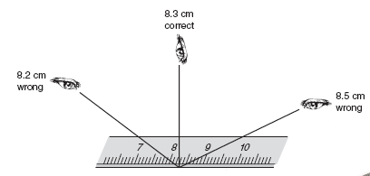
Methods of measuring - LENGTH
The metre rule
Correct way to read the scale on a ruler
Position eye perpendicularly at the mark on the scale to avoids parallax errors
Another reason for error: object not align or arranged parallel to the scale

Slide 4
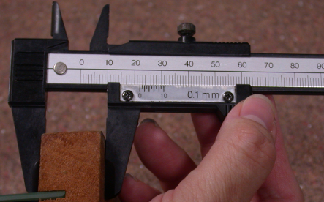
Methods of measuring - LENGTH
The vernier caliper
Very versatile instrument used for measuring the dimensions of an object, the dimensions of a hole, or the depth of a hole
Range is up to 100mm and it can be read to ± 0.1 mm
Should be aware of
  Zero error (systematic error) - very likely

Slide 5
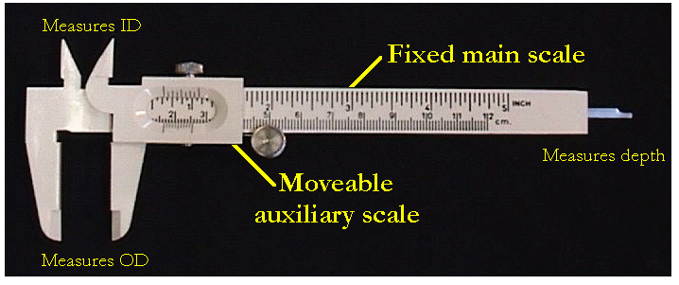
Methods of measuring - LENGTH
The vernier caliper

Slide 6
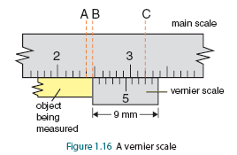
Methods of measuring - LENGTH
The vernier caliper
Here the eighth marking on the vernier scale coincides with the marking at C on the main scale
Therefore the distance AB is 0.08 cm, i.e. the length of the object is 2.48 cm

Slide 7
Methods of measuring - LENGTH
The micrometer screw gauge
To measure diameter of fine wires, thickness of paper and small lengths, a micrometer screw gauge is used
The micrometer has two scales:
  Main scale on the sleeve
  Circular scale on the thimble
There are 50 divisions on the thimble
Each division on the circular scale = 0.01 mm
One complete turn of the thimble moves the spindle by 0.50 mm
Should be aware of
  Zero error (systematical error) - very likely

Slide 8
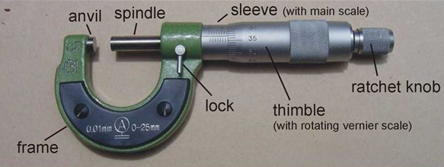
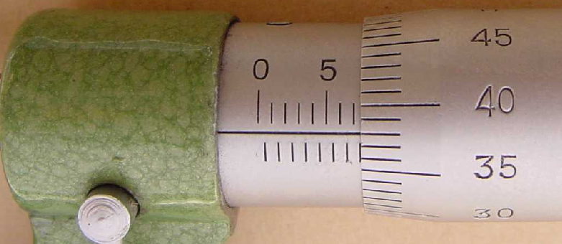
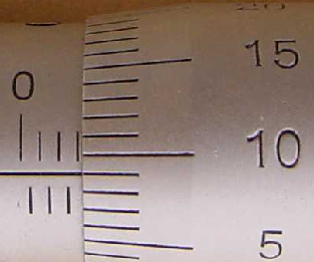
Methods of measuring - LENGTH
The micrometer screw gauge

Slide 9
Methods of measuring - LENGTH
The micrometer screw gauge
Precautions when using a micrometer
1. Never tighten thimble too much
  Modern micrometers have a ratchet to avoid this
2. Clean the ends of the anvil and spindle before making a measurement
  Any dirt on either of surfaces could affect the reading
3. Check for zero error by closing the micrometer when there is nothing between the anvil and spindle
  The reading should be zero, but it is common to find a small zero error
  Correct zero error by adjusting the final measurement

Slide 10
Methods of measuring - PRESSURE
Difference in gas pressure can be measured by comparing the heights of a liquid in the 2 arms of a U-tube. Instrument is called a manometer.
The pressure of the gas is the difference in height, since pressure, p = hρg.
Barometers are another equipment can be used to directly read pressure.
Should be careful
  to read the meniscus
    if concave, read the bottom of the meniscus
    if mercury, read the convex or top part of the meniscus
  to ensure tube is vertical.
  of parallax error.

Slide 11
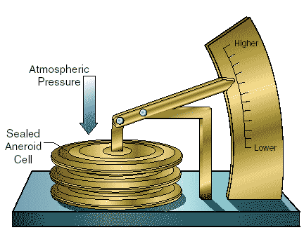
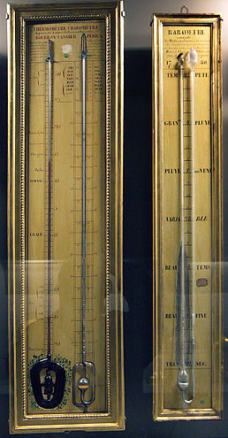
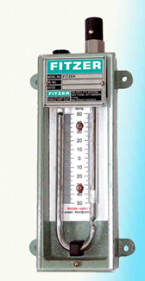
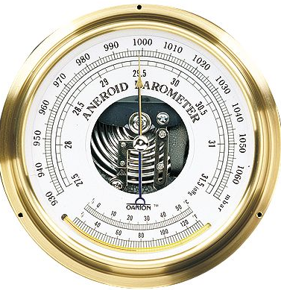
Methods of measuring - PRESSURE
Aneroid Barometer
Mercury Barometer
Manometer

Slide 12
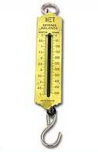
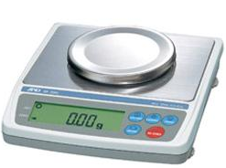
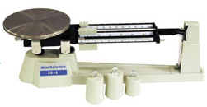
Method of measurement - MASS
The spring balance
Based on Hooke’s Law which states that extension is proportional to the load.
Measurement is made directly by a moving pointer over the scale.
should be careful of zero error, usually has a zero error adjustment screw.
Should be careful parallax error.
Top-pan balance
Ensure that the initial (unloaded) reading is zero.
There is a control for adjusting the zero reading.
Uncertainty will be quoted by manufacturer in the manual, usually as a percentage of the reading shown on the scale.
Lever balances
Based on principle of moments where unknown mass is balanced by a slider, calibrated in mass units.
Should be aware of zero error, parallax error.

Slide 13
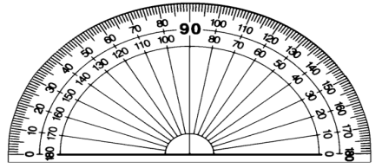
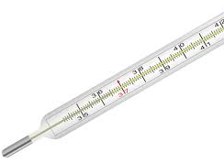
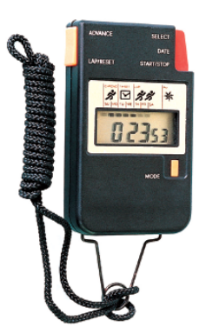
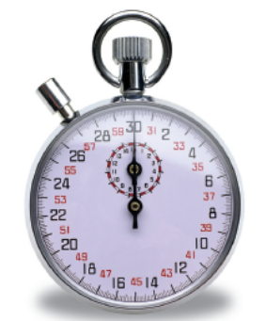
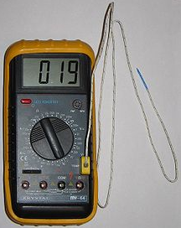
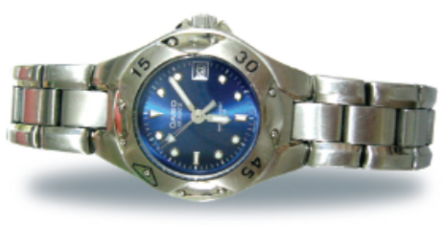
Method of measuring…
ANGLE
- Protractor
TEMPERATURE
- Mercury-in-glass thermometer
- Thermocouple thermometer
TIME
- Stop watches
-Watches

Slide 14
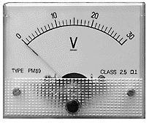
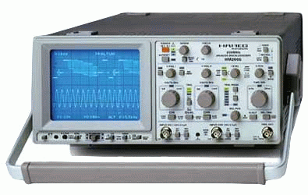
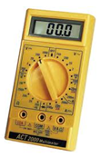
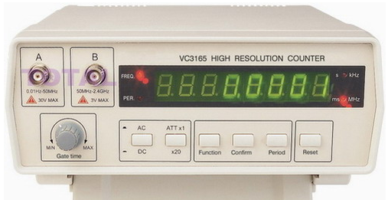
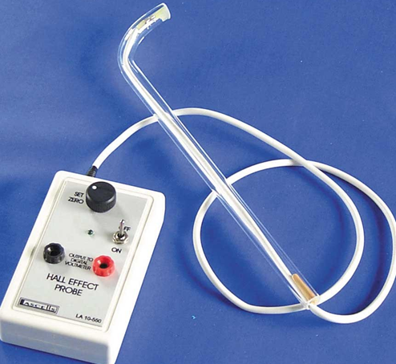
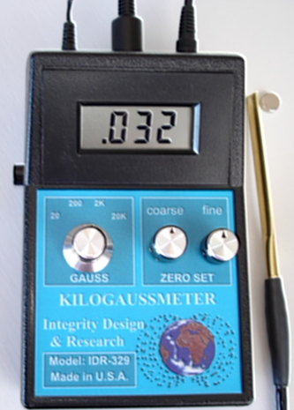
Method of measuring…
VOLTAGE, CURRENT, RESISTANCE
- analogue meters
- galvanometer
- digital meters
- multi-meters
- cathode ray oscilloscope
FREQUENCY
- Cathode ray oscilloscope
- Frequency counter
MAGNETIC FLUX DENSITY
- Hall Probe

Slide 15
Introduction – Measurement & Errors
Experiments are designed to obtain a quantitative result for a physical quantity. It involves measurements.
Measurements of : length, angle, mass, time, temperature and electrical quantities (i.e. current, voltage).
In the course of taking such measurements, measurement errors are inevitable.
Error in a scientific measurement means, the inevitable uncertainty that occurs in all measurements, arising from the limitations of the observer, the measuring instrument used, the methods used or a combination.

Slide 16
Errors - Terminology & Types
Basically errors can be divided into two major types:
  (a) Round-off errors
    Round-off errors are due to the rounding off of non-terminating numbers, like π, to a certain number of decimal places or significant figures.
  (b) Measurement errors.
    Measurement errors are errors due to limitations. These are further divided into systematic and random errors.

Slide 17
Measurement Errors
No measurement is exact .
All measurements will have some degree of error or uncertainty .
An error is the difference between the measured value and the actual value.
Measurement errors arising from the limitations of the observer, the measuring instrument used, the methods used or a combination.
Measurement errors can be classified into two types: systematic and random errors.
A systematic error causes a measurement to be consistently shifted in one direction only (i.e. always too high or too low from its actual).
A random error causes result to scatter about a mean value. (i.e. has an equal chance of being too high or too low from its actual).

Slide 18
Systematic Errors
Systematic errors are due to:
(a) instruments faults. (zero error, calibration error)
(b) faults in the surrounding conditions. (wrong assumption eg: weather conditions)
(c) mistakes made by the observer. (consistently underestimate / overestimate a reading)
  also called parallax error
Systematic errors cannot be reduced by repeating the measurements & averaging.
BUT can be eliminated if the source of errors are known.
Elimination can be done by using a different instrument, calibration of the instrument used and by using correct experimental and measurement techniques:-
(a) ensure zero reading before start (no zero error)
(b) compare the device with other to check for discrepancy

Slide 19
Random Errors
Random errors are due to:
(a) faults in the surrounding conditions. (varying in temperature, pressure reading)
(b) mistakes made by the observer. (sometimes underestimate, sometimes overestimate a reading)
  also called parallax error
Random errors cannot be eliminated in any way.
But can be reduced by repeating the measurements & averaging.

Slide 20
Precision and accuracy
Precision refers to the extent or limit of sensitivity of a given measuring instrument to obtain the readings of physical quantity being measured.
Precision also refers to the degree of measuring instrument to record consistent readings for each measurement by the same way.
High precision means small random errors.
Accuracy refers to the percentage uncertainty in a given measurement.
Accuracy also refers to the degree of measuring instrument to record readings close to the actual value.
Same instrument with a given precision, used to measure quantity of different magnitude will give rise to different accuracy.
High accuracy means small systematic errors.

Slide 21
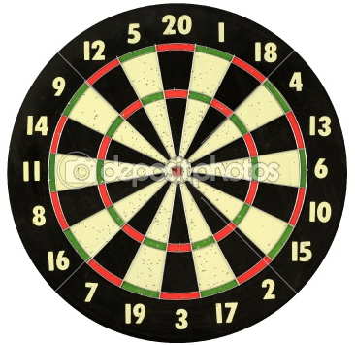
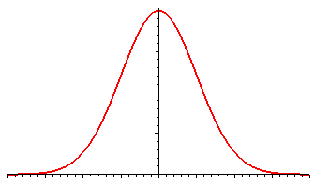
Accuracy & Precision of an experiment
A precise/consistent readings are not necessarily accurate readings.
Example: if the zero reading of a micrometer screw gauge is not noted and taken care of, measurements made using the gauge may be precise/consistent but inaccurate.
The readings may be higher (for positive zero error) or lower (for negative
zero error).
Example of the dart board & bell curve graph.

Slide 22
Calculation of Uncertainty in Derived Quantity
Generally, all readings can be recorded in the form of R ± ∆R, in which
R is the actual value and ∆R is the actual uncertainty.
Actual/Absolute uncertainty = ∆R (only 1s.f)
Fractional uncertainty = (Actual uncertainty) / (Actual value)
= ∆R / R (max 2 s.f)
Percentage uncertainty = (Fractional uncertainty) x 100%
= (∆R / R) x 100 % (max 2 s.f)

Slide 23
Calculation of Uncertainties for different Mathematic Expressions
For ADDITION or SUBTRACTION:
[Eg: x = y + z or x = y – z]
The overall uncertainty is ∆x = ∆y + ∆z
For MULTIPLICATION or DIVISION:
[Eg: x = 5yªz^{b} or x = 3(yª / z^{b})]
The overall fractional uncertainty is ∆x / x = a(∆y / y) + b(∆z / z)
For MULTIPLICATION or DIVISION with a CONSTANT VALUE:
[Eg: x = 5(y+ ∆y) or x = (1/2) (y+ ∆y)]
The overall uncertainty is ∆x = 5(∆y) or ∆x = (1/2)(∆y)

